Slide 1
Establishing a Mission and Vision
Residents Council Training Module 1

Slide 2
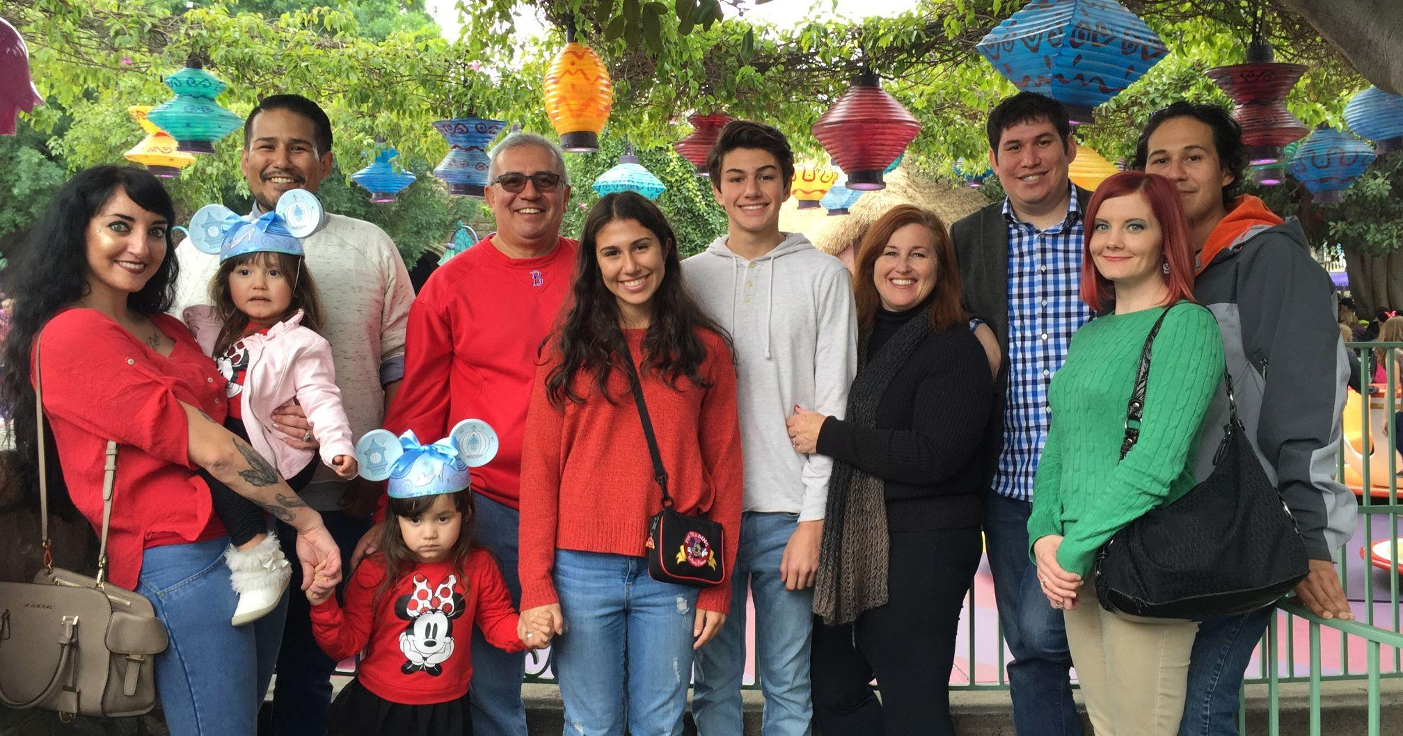
Wendy Hernandez
Personal
I am a wife and mother of two college-aged children and a bonus mother of three boys
I grew up in rural area of the Central Valley
I love to cook and work in our yard! I am an animal lover! I also love to read- mostly books about people, cultures and art!
Professional
I have worked many jobs starting at age 15 including washing cars, cleaning houses and serving food.
I became a teacher, a principal and now Supervisor of Early Education in Central Unified
I am a member of the Local Planning Council
My philosophy of education is to provide equitable access to all children. I am also passionate about empowering people to become leaders.
Notes:
3 minutes

Slide 3
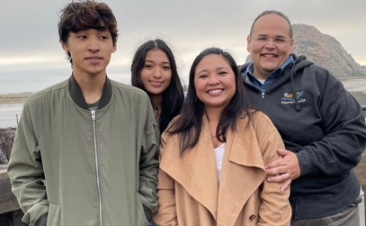
Mike Espinoza
Personal
I’ve got two teenagers, Alex (19) & Cathy (15)- and my pug, Luna :)
I’m originally from Houston, Texas- we moved to Fresno in 2016.
I love to read science fiction and political books, and I love Star Wars!
Professional
After college, in 2002, I taught high school for 3 years.
I’ve been a professional community organizer ever since, organizing janitors, teachers, faith leaders, parents, and students.
I’ve led organizing and political campaigns all across the Southwestern US, but the Residents Council is the biggest yet!
I believe that ordinary people, residents in their communities, should be able to shape the terms by which we live our lives.
Notes:
3 minutes

Slide 4
Agenda
Meet the Presenters
Group Norms
Review Outcomes
Introduction to Vision, Mission, Values
Create Vision
Start Mission Group Work
Conclusion and next steps
Notes:
Mike shares agenda 2 minutes

Slide 5
So, before we get started, let’s review our norms...
Residents Council Norms:
1. Be open to new ideas
2. Listen to each speaker
3. Make equal time for all to share
4. In person meeting: Please keep your phone on silent, and if you need to answer
the phone, please excuse yourself from the room.
5. During a virtual meeting we encourage you to have camera on to be fully
engaged
***Are there any norms we should add?
Notes:
Add ideas for norms in the chat. Wendy explains norms 2 min

Slide 6
Vocabulary
Group norms- expectations of the way the group will work together to achieve its goals
Collaborate- the action of working with someone to create something
Contribute- help to cause or bring about
Vision- describes the basic human emotion that founders intend to create an impact on the world
Mission- communicates the purpose and action of the vision and creates a sense of identity for the organization.
Values- one’s judgement of what is important in life
Notes:
Wendy reviews vocabulary 3 min

Slide 7
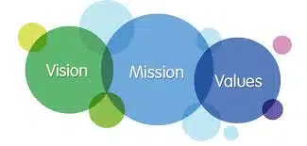
Objective or Outcomes for our Training
Today we will create a Vision and Mission statement for our Residents Council. This will be done collaboratively to ensure it is created in a way that is aligned to members’ values.
This will help guide our work and keep us focused on the change we want in our community.
Notes:
2 min

Slide 8
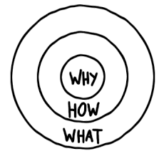
Why, How, What?
“Why” will always drive this work with the vision in mind created with our values.
“How” will include our mission statement and goals to achieve in this process.
“What” is the product we will create in the end together.
These are the Big Ideas!
Notes:
Mike explains the Golden Circle 5 min

Slide 9
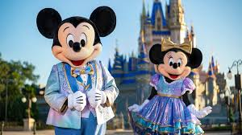
Disney has a very clear vision and mission...
Disney 50th Anniversary
0th Anniversary Celebration Begins October 1st
Notes:
Show video 3 minutes

Slide 10

Disney’s Vision
Disney’s Vision: To make people happy.
Disney makes the vision come to life as they work on the following features contained in its vision statements:
World’s leader
Producer and provider of entertainment and information
Notes:
Wendy talks about Disney’s vision- 3 minutes

Slide 11
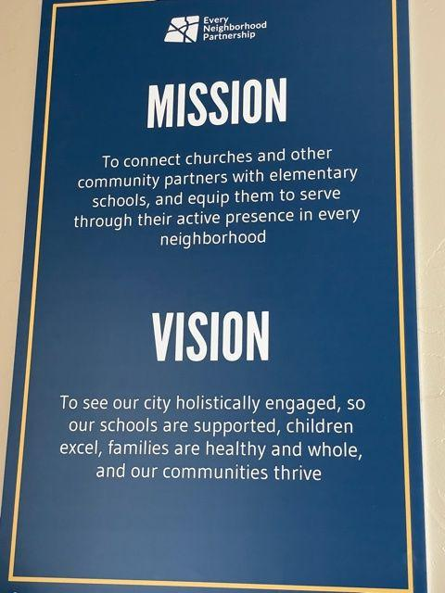
Why is a Vision & Mission important for us?
The challenge is that we come from all walks of life, all races and ethnicities, we can unite around some shared ideas.
We need to state where we would like this Residents Council to go, and how we hope to change our world!
Powerful Examples of Vision/Mission Statements:
Every Neighborhood Partnership
Children’s Services Network
Notes:
Mike connects Disney to our Community- 5 minutes

Slide 12
Why is a Vision & Mission important for Us?
The challenge is that we come from all walks of life, all races and ethnicities, we can unite around some shared ideas.
We need to state where we would like this Residents Council to go, and how we hope to change our world!
Powerful Examples of Vision/Mission Statements:
Every Neighborhood Partnership
Children’s Services Network
Children’s Services Network
Mission:
At Children’s Services Network staff works every day towards the mission of “Improving the quality of care for children of the Central Valley.”
Vision:
Every child has the right to receive the highest quality care available and Central Valley Children's Services Network is working towards achieving this vision in the Fresno County.
Notes:
Mike connects Disney to our Community- 5 minutes

Slide 13
Why is a Vision & Mission important for Us?
“Extra Credit” Homework Assignment:
What are the Mission, Vision or Values of your Anchor CBO?
Children’s Services Network
Mission:
At Children’s Services Network staff works every day towards the mission of “Improving the quality of care for children of the Central Valley.”
Vision:
Every child has the right to receive the highest quality care available and Central Valley Children's Services Network is working towards achieving this vision in the Fresno County.
Notes:
Mike connects Disney to our Community- 5 minutes

Slide 14
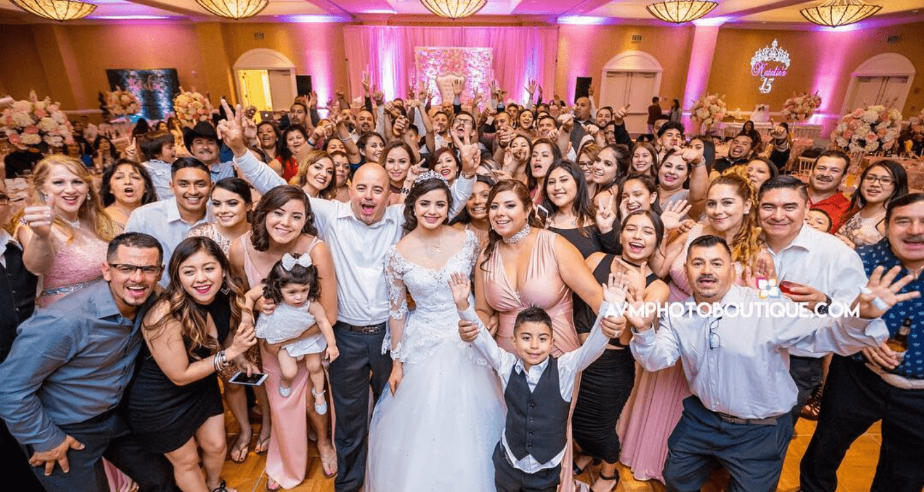
Have you ever planned a family trip or event?
How many people were helping you plan?
Was it easy to agree on things?
What worked well?
What did not work well?
Think for a minute and write this in your notes
Notes:
2 min Wendy & Mike tag team, talking about planning an event- participants write about in notes page

Slide 15
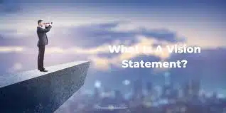
Let’s Create our Vision
You each have life experience that makes you an important part of creating this vision of what you see in the finished work.
On the paper that has been provided take 5 Minutes and draw out what your vision is for the children in our community. Add details. Do not worry about the art, it is just for you to see what you think it would look like if our children had all they needed to learn and grow.
What will it look like?
We will give you 20 minutes to share as a team about what you created.
Slide with an example next:
Notes:
5 minutes to draw on your own and then 20 minutes for team to collaborate on terms
They can use chart paper if in office, or will do break-outs on Zoom

Slide 16
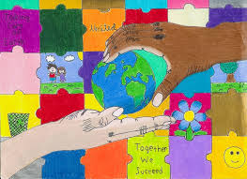
Example of a Vision Drawing

Slide 17
Create your vision in the box below
Notes:
5 minutes

Slide 18
Vision Group Work
By just using one or two word phrases to describe your vision... add those phrases to the chat or the menti below.
Remember, just one or two words only please…
Go to www.menti.com
and use the code 5698 1804
Notes:
20 min- in groups or break out groups

Slide 19

Whole Group Discussion
Let’s look at the main words and phrases that you came up with.
These words will help to create our vision statement that we will share at our next meeting.
Create statements for voting next time
Notes:
5 min

Slide 20

Developing our Mission Statement
Next we will think of the action we need to do to make our vision become a reality!
Reflect in your notes for 3 minutes on the work we need to do.
Then, meet with your team and combine those ideas into a phrase.
Next, create a gesture that will represent that action!
(Example: peace sign, heart with two hands together)
Notes:
5 min

Slide 21
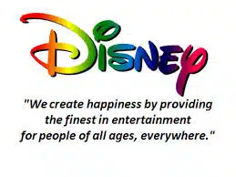
Mission Statement Examples
Children’s Services Network staff works everyday towards the mission of “Improving the quality of care for children of the Central Valley.”
Notes:
5 min Wendy

Slide 22
Teams Create Mission Phrase
THIS IS THE HOW>>>>>>>>
Each team will share in a photo with their phrase. Please email your photo and ideas to Wendy Hernandez at Bearnred3@gmail.com
We will share these at our next meeting and vote!
Notes:
3 min Wendy

Slide 23
Review Outcomes and Team Plans
We established out group norms and established partnerships with team members.
We developed our terms for a vision statement
We learned how to develop a mission statement and will develop a team statement and gesture to share at our next meeting.
Next Training:
Date & Time: September 21st 5:30-7:00 pm or September 25th 10:00-11:30 am
Topic: The Power of Meeting Face to Face
Notes:
10 min Mike & Wendy

